Slide 1
IBM InfoSphere Information Server
Lesson 3: Executing and Monitoring Jobs

Slide 2
Lesson Objectives
On completion of this lesson, you will be able to:
Executing and Monitoring Jobs
Introduction to Datastage Director
Options to run job

Slide 3
Executing and Monitoring Jobs

Slide 4
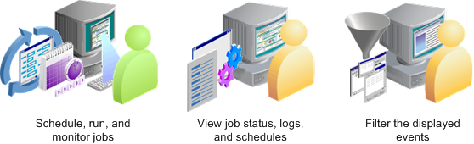
DataStage Director
Use to run and schedule jobs
View runtime messages
Can invoke directly from Designer
Tools > Run Director
Tasks that can be performed by the DataStage Director.

Slide 5
DataStage Director
How to run jobs?
You can open Director from within Designer by clicking Tools>Run Director.
In a similar way, you can move between Director and Designer.
There are two methods for running a job:·
Run it immediately.·
Schedule it to run at a later time or date.
To run a job immediately:·
Select the job in the Job Status view.
The job must have been compiled.·
Click Job>Run Now or click the Run Now button in the toolbar.
The Job Run Options window is displayed.

Slide 6
DataStage Director
The DataStage Director window is divided into two panes:
The Job Category pane lists all of the jobs in the repository.
The right pane shows one of three views: Status view, Schedule view, or Log view.
DataStage Director menu options:
Menu Option | Description
Project | Open another project, print, or exit.
View | Display or hide the toolbar, status bar, buttons, or job category pane, specify sorting order, change views, filter entries, show more details, or refresh the screen.
Search | Start a text search dialog box.
Job | Validate, run, schedule, stop, or reset a job, purge old entries from the job log file, delete unwanted jobs, clean up job resources (if this is enabled), set default job parameter values.
Tools | Monitor running jobs, manage job batches, start the DataStage Designer.
Help | Displays online help.

Slide 7
DataStage Director
DataStage Director has three view options:
The Status view displays the status, date and time started, elapsed time, and other run information about each job in the selected repository category.
The Schedule view displays job scheduling details.
The Log view displays all of the events for a particular run of a job.

Slide 8
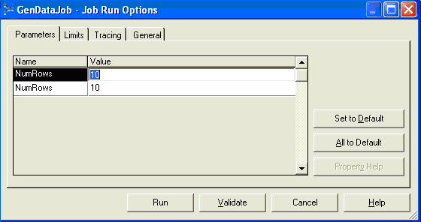
Run Options
The Job Run Options window is displayed when you click Job>Run Now.
This window allows you to stop the job after:·
A certain number of rows.
A certain number of warning messages.
Click Run to run the job after it is validated. The Status column displays the status of the job run.

Slide 9
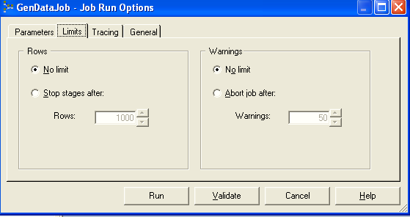
Run Options (Cont..d)
The Job Run Options window is displayed when you click Job>Run Now.
This window allows you to stop the job after:
A certain number of rows.
A certain number of warning messages.
Click Run to run the job after it is validated. The Status column displays the status of the job run.

Slide 10
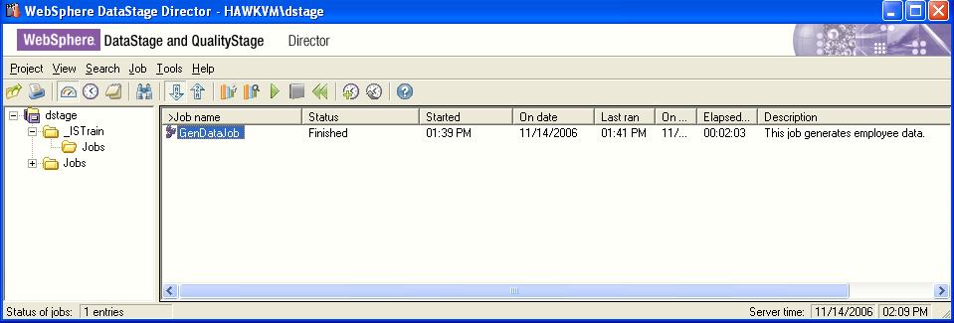
Director Status View

Slide 11
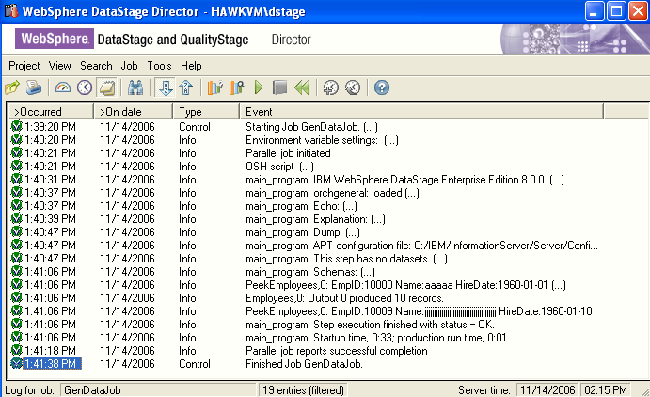
Director Log View
Click the Log button in the toolbar to view the job log.
The job log records events that occur during the execution of a job.
These events include control events, such as the starting, finishing, and aborting of a job; informational messages; warning messages; error messages; and program-generated messages.

Slide 12
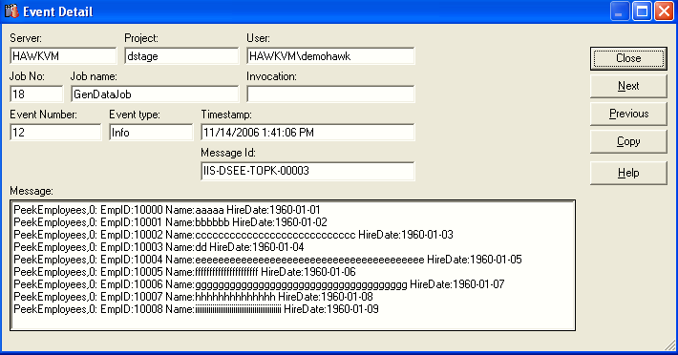
Message Details
Double-click on a message to open it up and read the details

Slide 13
Other Director Functions
Schedule job to run on a particular date/time
Clear job log of messages
Set job log purging conditions
Set Director options
Row limits
Abort after x warnings

Slide 14
Running Jobs from Command Line
dsjob –run –param numrows=10 dx444 GenDataJob
Runs a job
Use –run to run the job
Use –param to specify parameters
In this example, dx444 is the name of the project
–In this example, GenDataJob is the name of the job
dsjob –logsum dx444 GenDataJob
Displays a job’s messages in the log
Documented in “Parallel Job Advanced Developer’s Guide”

Slide 15
Q&A
Which stage can be used to display output data in the job log?
Which stage is used for documenting your job on the job canvas?
What command is used to run jobs from the operating system command line?

Slide 16
Q&A
Peek stage
Annotation stage
dsjob -run

Slide 17
Unit summary
Having completed this unit, you should be able to:
Design a simple Parallel job in Designer
Define a job parameter
Use the Row Generator, Peek, and Annotation stages in a job
Compile your job
Run your job in Director
View the job log

